Slide 1
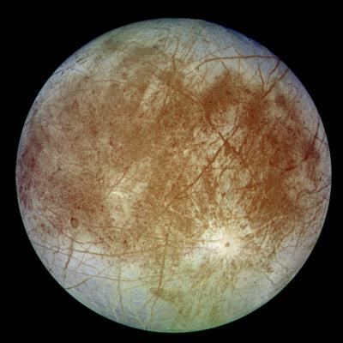



Looking for Life on
EUROPA
+0
+1
+2
Contaminate Europa’s Ocean!
Find Evidence of Past Life!
Discover an alien species!
Measure Ocean Salinity
+4
Drill for an Ice Sample
+6

Slide 2
The search for extraterrestrial (alien) life
Life has three requirements: water, energy and chemical elements. Scientists believe Europa may have all three with energy potentially coming from Uranus’s radiation or theoretical thermal ocean vents. Life on Europa could take on many forms such as microbes or could be more complex. If life is found, this could indicate that life in the universe is more abundant than we think!
One consideration when looking for life is contamination. We must be careful to not contaminate that planet with Earth life and not to bring extraterrestrial life forms back to earth! This important practice is called Planetary Protection.
Measuring Europa’s salinity
Scientists think Europa’s ice shell is 10 to 15 miles thick, floating on an ocean 40 to 100 miles deep. This means that its ocean may contain twice as much water as all of Earth’s oceans combined!
Currently, the clues to the composition of Europa’s ocean come from Earth telescopes collecting spectra, which are like chemical fingerprints encoded in the light reflected by the compounds. Future surface missions to Europa’s maybe able to measure this directly.
Drilling for ice samples
Europa’s water-ice surface contains many long, linear cracks as well as reddish-brown patches. These patches may contain salts and sulfur compounds that have been mixed with the ice and modified by radiation. This surface composition may hold clues to the moon's potential as a habitable world. Collecting samples from the surface will help scientists learn more about Europa’s surface!
Notes:
NASA's Galileo spacecraft (from 1995 to 2003) made numerous flybys of Europa. This mission suggested Europa’s ice layer could be slowly churning due to heat from below.

